Slide 1
Creating a React Application
Creating an application
Running the application

Slide 2
Section 1: Creating an Application
Overview
Creating a React TypeScript app
Reviewing the application
Application home page
Source code entry point
Functional components

Slide 3
Overview
We'll use TypeScript for our React demos today
We're going to use Vite to create the apps
Generates a template React app, config, etc.
Can also be used to create apps in Vue, Svelte, etc.
See https://vitejs.dev/
Install Vite as follows (requires Node.js 18 or above):
npm install -g vite@latest
3

Slide 4
Creating a React TypeScript Application
Run Vite and specify these options, to create a simple app:
Project name: demo-app
Framework: React
Variant: TypeScript
Then install packages for your application, as follows:
npm create vite@latest
cd demo-app
npm install
4

Slide 5
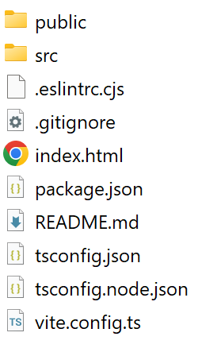

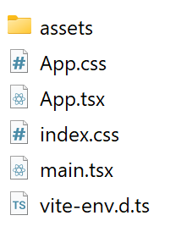
Reviewing the Application
Here's the structure of the generated application:
public folder
src folder
5

Slide 6
Application Home Page
The application home page is /index.html
<!doctype html>
<html lang="en">
<head>
<title>Vite + React + TS</title>
…
</head>
<body>
<div id="root"></div>
<script type="module" src="/src/main.tsx"></script>
</body>
</html>
/index.html
6

Slide 7
Source Code Entry Point
The source code entry point is /src/main.tsx
Aside: For info about React strict mode, see:
https://react.dev/reference/react/StrictMode
import { StrictMode } from 'react'
import { createRoot } from 'react-dom/client'
import './index.css'
import App from './App.tsx'
createRoot(document.getElementById('root')!).render(
<StrictMode>
<App />
</StrictMode>,
)
/src/main.tsx
7

Slide 8
Functional Components
In the generated code, App is a functional component
import { useState } from 'react'
…
function App() {
const [count, setCount] = useState(0)
return (
<>
…
<button onClick={() => setCount((count) => count + 1)}>
count is {count}
</button>
…
</>
)
}
export default App
/src/App.tsx
8

Slide 9
Section 2: Running the Application
Running the app in dev mode
Hot reloading
Building the app for production
Serving the production application
Pinging the production application

Slide 10
Running the App in Dev Mode (1 of 3)
You can run the app in dev mode as follows:
What this does:
Transpiles TS code into ES (see tsconfig.json for version)
Transpiles JSX/TSX files into ES
Builds the application in memory
Starts a dev server to host the application
The dev server is on http://localhost:5173
npm run dev
10

Slide 11
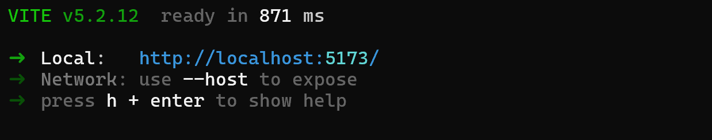
Running the App in Dev Mode (2 of 3)
Output from the command on the previous slide:
11

Slide 12
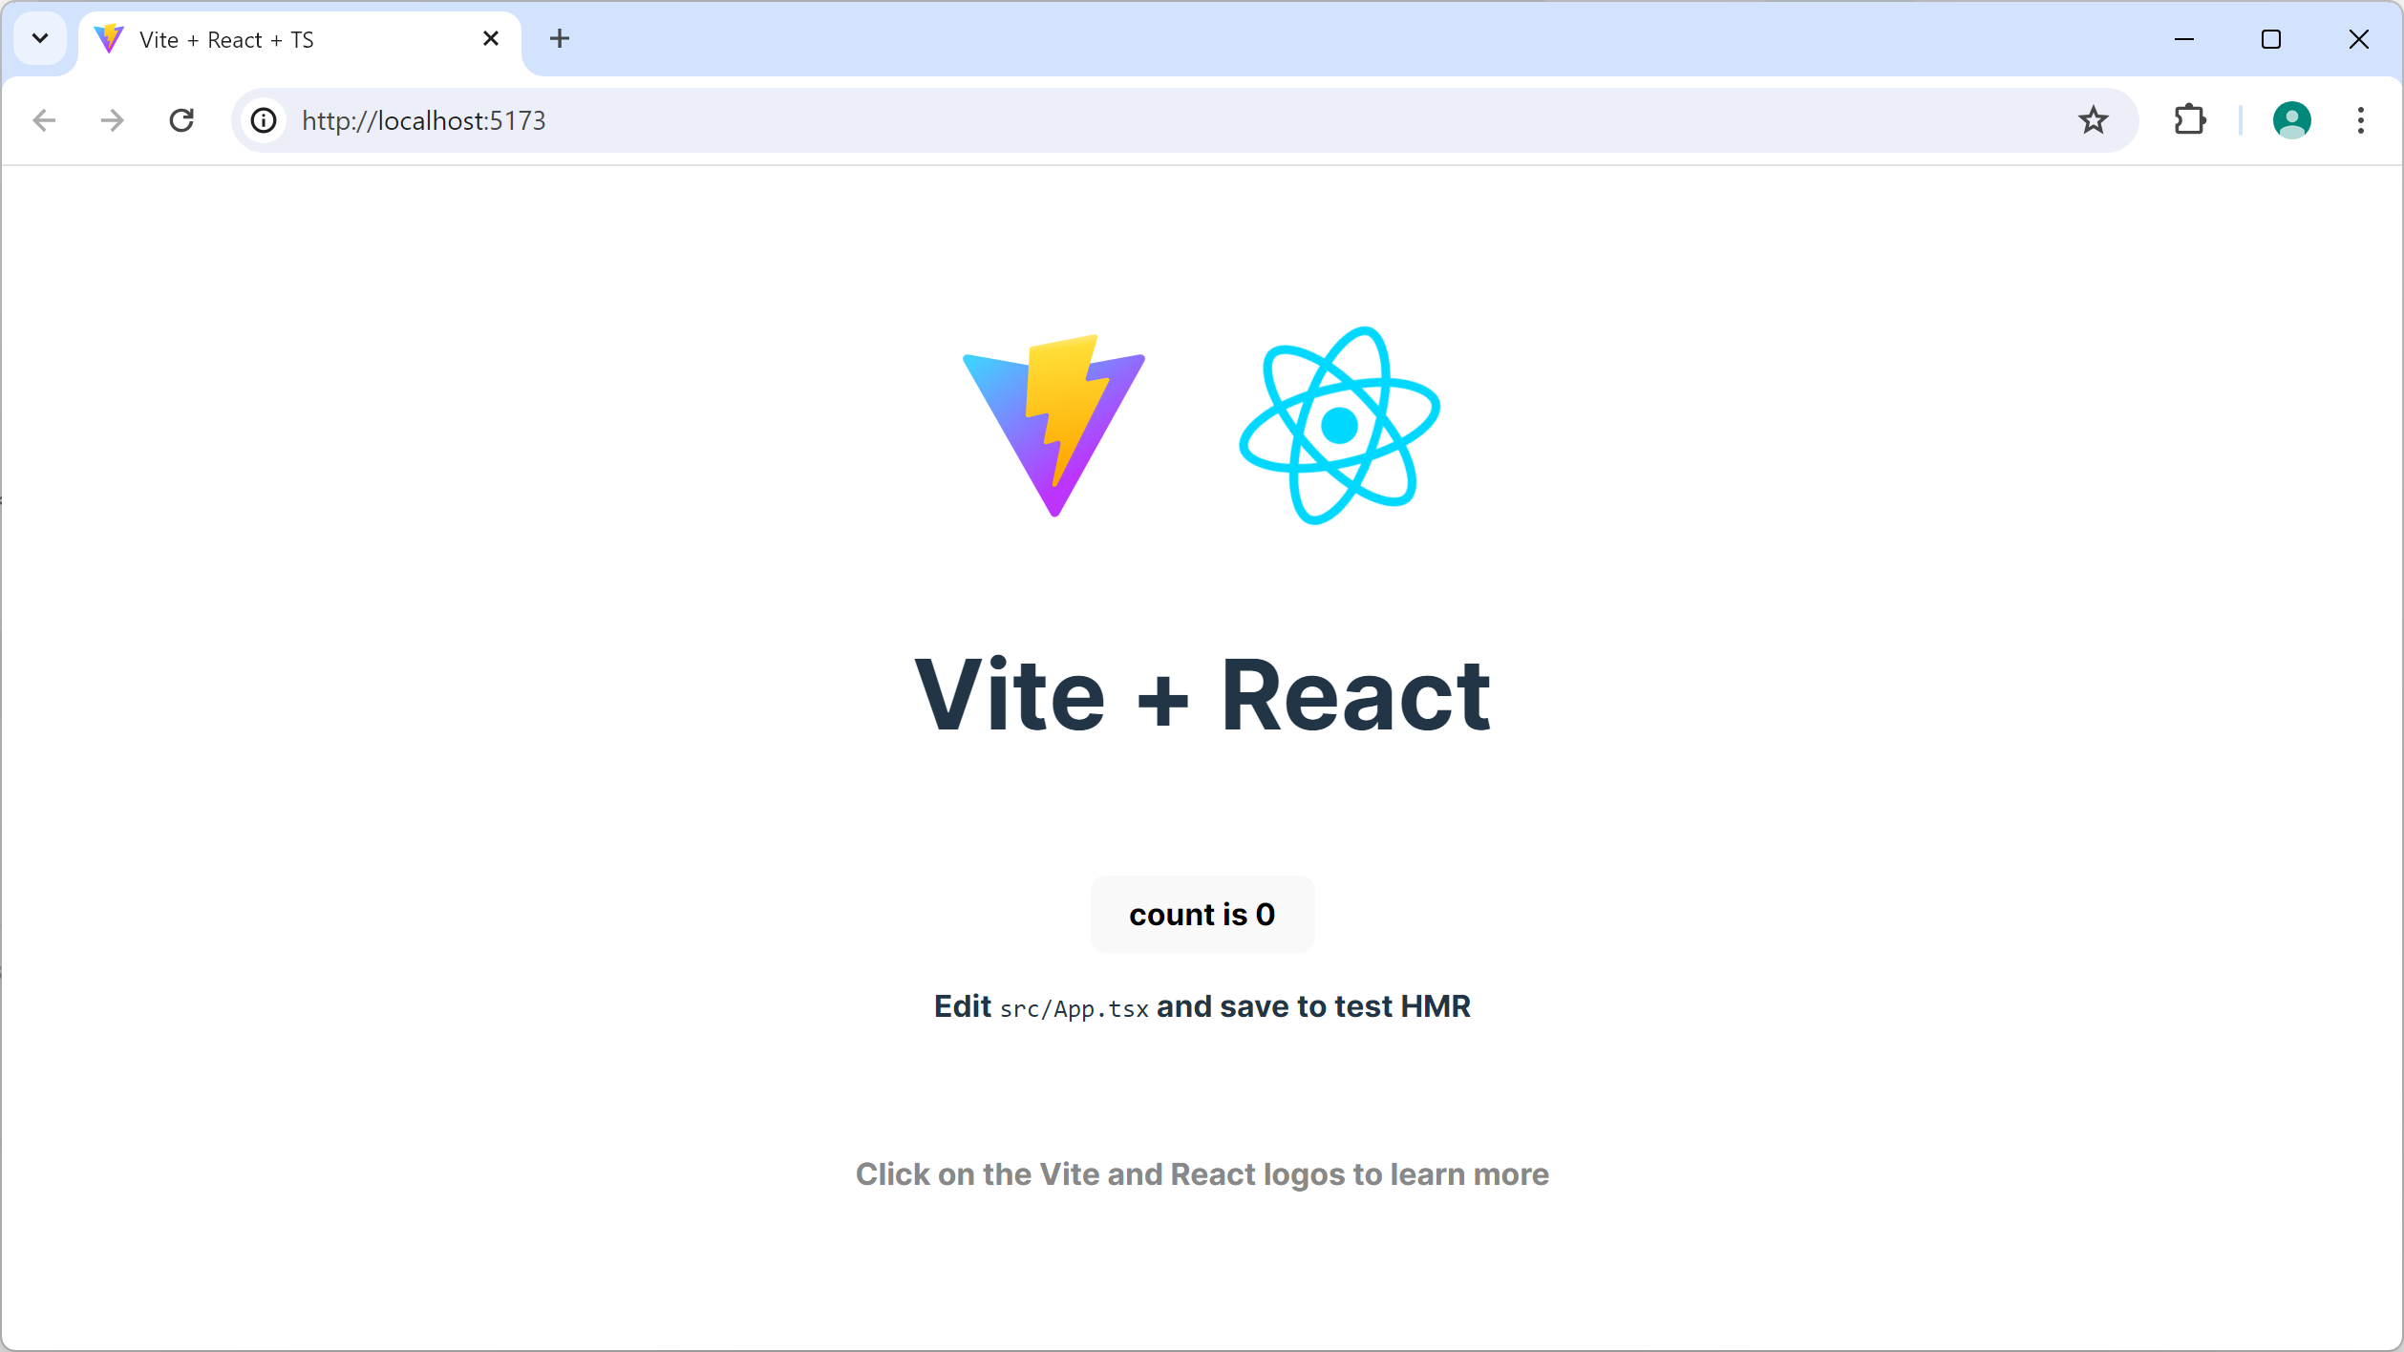
Running the App in Dev Mode (3 of 3)
Ping the app at http://localhost:5173
12

Slide 13
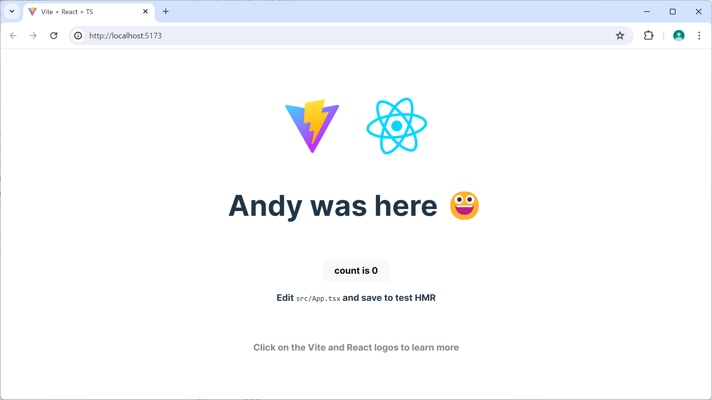
Hot Reloading
Hot reloading is supported
If you edit any source files, the app will be rebuilt and refreshed automatically in the browser
13

Slide 14
Building the Application for Production
You can build the application for production as follows:
This creates a dist folder that contains a production build of your application
dist/index.html - Home page
dist/assets/*.js - Minified JS chunk files
dist/assets/*.css - Minified CSS files
npm run build
14

Slide 15
Serving the Production Application
You can now run the application on a production server
E.g., install the Node "serve" server:
Then serve the production build of the app as follows:
-s option - Location of app (i.e., the dist folder)
-l option - Port to listen on (default is 5000)
npm install -g serve
serve -s dist -l 8080
15

Slide 16
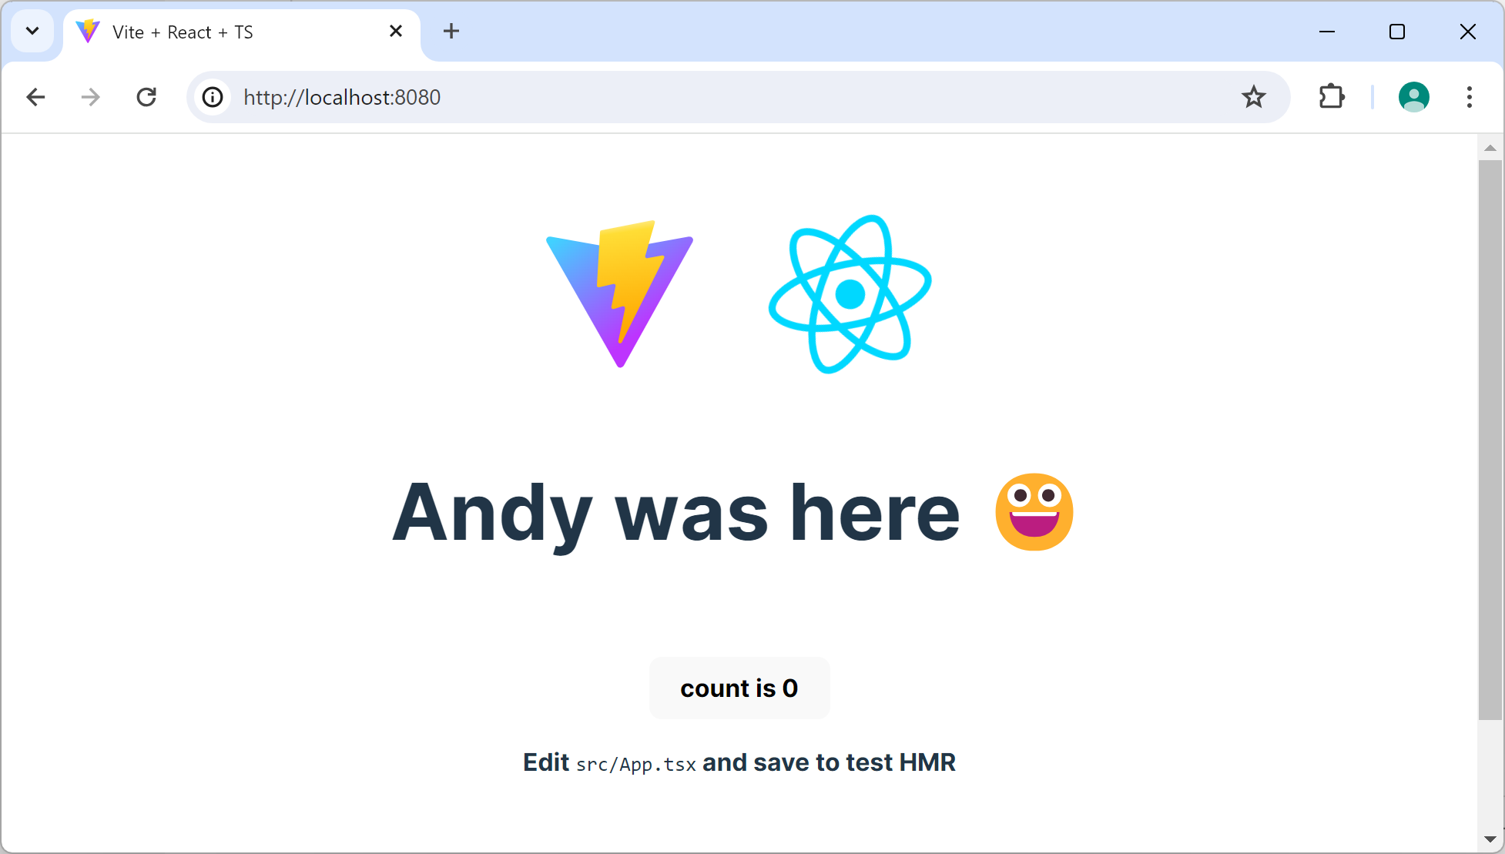
Pinging the Production Application
Open a browser and navigate to the following URL:
http://localhost:8080/
16

Slide 17
Summary
Creating an application
Running the application

